Slide 1


“Information Security”
Lecture # 7
Dr. Engr. M Malook Rind
Ph.D (I.T), ME (CSN), MBA (MIS), BE (CS)
CCNA, CCNP, Juniper Certified.
Professor (Computer Science)

Slide 2
Contents
Public Key Infrastructure
Cryptographic Protocols
Dr. M Malook Rind Information Security Lecture 7

Slide 3
Public Key Infrastructure (PKI)
Public Key Infrastructure (PKI)
Describe the components of Public Key Infrastructure (PKI)
Define digital certificates
Describe the different cryptographic protocols
Explain how to implement cryptography
Dr. M Malook Rind Information Security Lecture 7

Slide 4
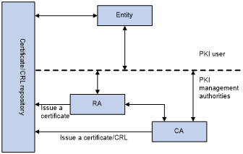
Public Key Infrastructure (PKI)
A public key infrastructure (PKI) is a set of roles, policies, hardware, software and procedures needed to create, manage, distribute, use, store and revoke digital certificates and manage public-key encryption.
The purpose of a PKI is to facilitate the secure electronic transfer of information for a range of network activities such as e-commerce, internet banking, confidential email and growing Internet of Things (IoT).
In cryptography, a PKI is an arrangement that binds public keys with respective identities of entities.
entity/users/subscriber scan be individual end users, web servers, embedded systems, connected devices, or programs/applications that are executing business processes
Dr. M Malook Rind Information Security Lecture 7

Slide 5
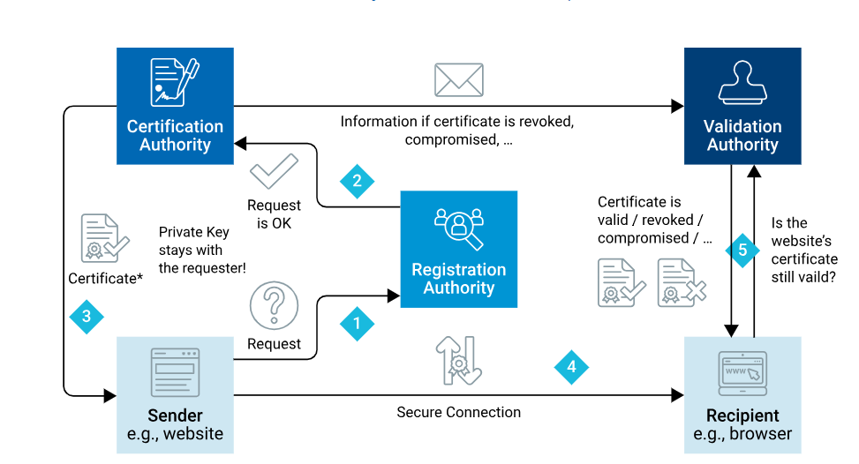
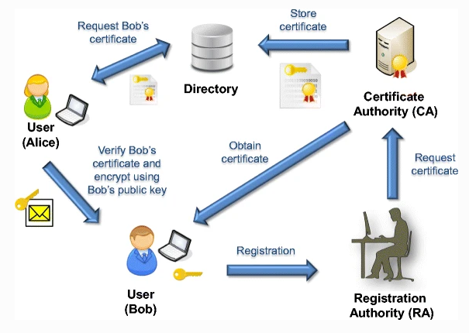
Public Key Infrastructure (PKI) – How it works
The purpose of a PKI is to facilitate the secure electronic transfer of information for a range of network activities such as e-commerce, internet banking, confidential email and growing Internet of Things (IoT).
Digital Certificate issuance
Digital Certificate Usage
Dr. M Malook Rind Information Security Lecture 7

Slide 6
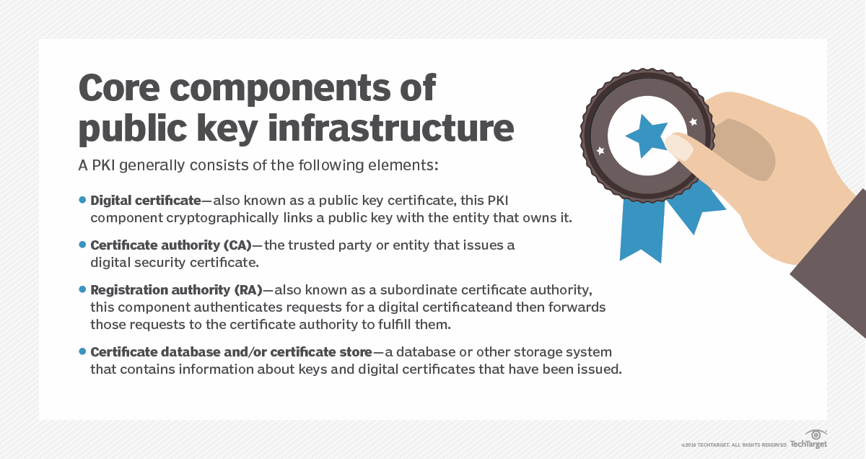
Public Key Infrastructure (PKI)
Dr. M Malook Rind Information Security Lecture 7

Slide 7
Digital Certificates
A Digital Certificate is an electronic document which provides information to prove the identity of an entity. It binds the identity of an entity to its public key.
Digital Certificate is one of the common application of cryptography
Using digital certificates involves
Understanding purpose
Knowing how they’re managed
Determining which type of digital certificate is appropriate
Dr. M Malook Rind Information Security Lecture 7

Slide 8
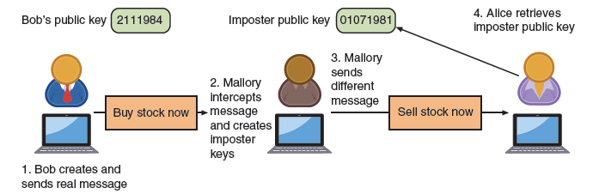
Digital Certificates - Defining Digital Certificates
A digital signature in asymmetric cryptography is s used to prove a document originated from a valid sender.
However, a digital signature has a weakness
it can only prove the owner of the private key and does not necessarily confirm the true identity of the sender.
Imposter could post public key under sender’s name
In order to bind public keys with their associated user (owner of the private key), PKIs use digital certificates
Dr. M Malook Rind Information Security Lecture 7

Slide 9
Digital Certificates - Defining Digital Certificates
A digital certificate is a technology used to associate a user’s identity to a public key and that has been digitally signed by a trusted third party.
Much as a passport certifies one’s identity as a citizen of a country, the
digital certificate establishes the identity of users within the ecosystem.
The third party is:
Used to help solve the problem of verifying identity
Verifies owner and that the public key belongs to that owner
A digital certificate is basically a container for a public key.
Typically, a digital certificate contains information such as:
the owner’s name or alias,
the owner’s public key,
the name of the issuer,
the digital signature of the issuer,
the serial number of the digital certificate,
and the expiration date of the public key
It can contain other user-supplied information, such as:
an email address, postal address, and basic registration information
When a sender sends a message to receiver, he does not ask her to retrieve his public key from a central site. Instead, sender attaches the digital certificate to the message.
When receiver receives the message with the digital certificate, she can check the signature of the trusted third party on the certificate. If the signature was signed by a party that she trusts, then receiver can safely assume that the public key—contained in the digital certificate—is actually from sender.
Digital certificates make it possible for receiver to verify sender’s claim that the key belongs to him and prevent an attack that impersonates the owner of the public key.
Dr. M Malook Rind Information Security Lecture 7

Slide 10
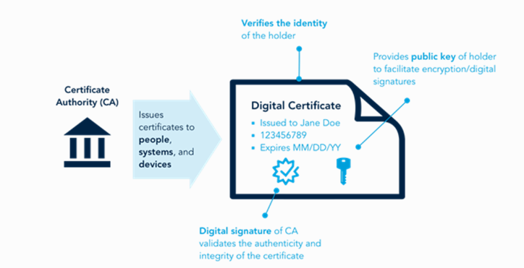
Digital Certificates - Defining Digital Certificates
The third party is:
Used to help solve the problem of verifying identity
Verifies owner and that the public key belongs to that owner
Dr. M Malook Rind Information Security Lecture 7

Slide 11
Digital Certificates - Managing Digital Certificates
- Several entities and techs are used to manage digital certificates
Certificate authorities (CAs)
Certificate Management
- Certificate authorities : issue the digital credentials used to certify the identity of users
A Certification Authority (trusted third party) issues a certificate to an entity after verifying its identity.
If a user wants a digital cert
After generating a public/private key, user must complete request with info such as name, address, email, known as a Certificate Signing Request (CSR)
User electronically signs CSR and sends it to an intermediate CA
An intermediate CA processes CSR and verifies authenticity of user
Intermediate CAs are subordinate entities designed to handle specific CA tasks such as
Processing cert request and verifying the identity of the individual
Famous CA are DigiCert, Verisign, Global Sign
Dr. M Malook Rind Information Security Lecture 7

Slide 12
Digital Certificates - Managing Digital Certificates
- Certificate management
Certificate Repository (CR )
A certificate repository (CR) is a publicly accessible centralized directory of digital certificates
Used to view the status of a digital certificate.
The directory can be managed locally by setting it up as a storage area that is connected to the CA server
Certificate Revocation
Reasons a cert would be revoked
Cert is expired
Details of the cert have changed
Private key has been lost/exposed/compromised (or suspected to have been)
The status of a certificate can be checked in two ways
Certificate Revocation List (CRL) on local computer is a list of digital certs that have been revoked
Online Certificate Status Protocol (OCSP) performs a real-time look at of Certificate’s Status.
Browser sends the certs info to a trusted entity known as an OCSP Responder
OCSP Responder provides immediate revocation info on that cert
Dr. M Malook Rind Information Security Lecture 7

Slide 13
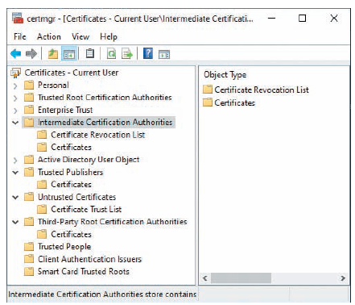
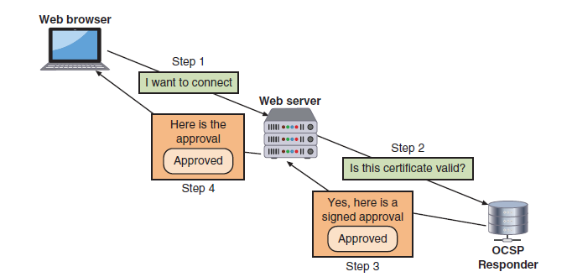
Digital Certificates - Managing Digital Certificates
Approved root digital certificates and intermediate certificates are distributed in one of three ways
through updates to the OS
updates to the web browser
digital certificate is hard-coded (pinned) within the app (program) that is using the certificate (commonly used in mobile messaging apps).
Certificate Revocation List (CRL)
OCSP stapling
Dr. M Malook Rind Information Security Lecture 7

Slide 14
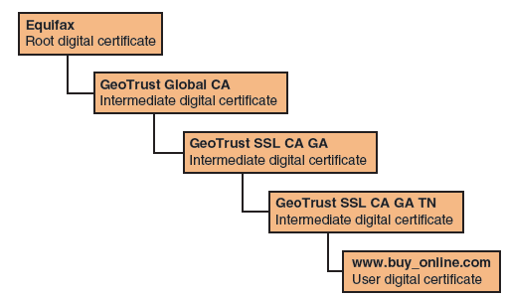
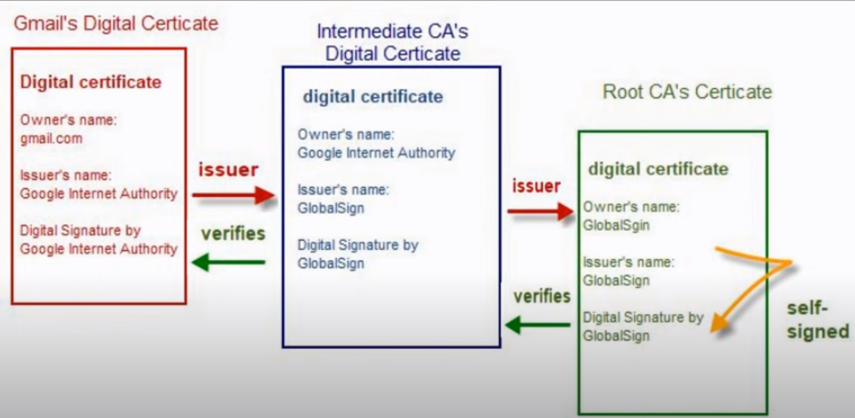
Digital Certificates - Types of Digital Certificates
Digital certificates can be grouped into the broad categories
- Root Digital Certificates
Process of verifying a digital cert is genuine depends upon certificate chaining
Certificate chaining creates a path between the trusted root CAs and intermediate CAs with the digital certificates that have been issued.
Every certificate is signed by the entity that is identified by the next-higher certified entity in the chain.
In this way, the trust of a certificate can be traced back to the highest level of CA.
Beginning point of chain is known as root digital certificate and created/verified by a CA
They’re self-signed and don’t depend on any higher-level authority
Endpoint of chain is user digital certificate itself
Certificate chaining
Dr. M Malook Rind Information Security Lecture 7

Slide 15
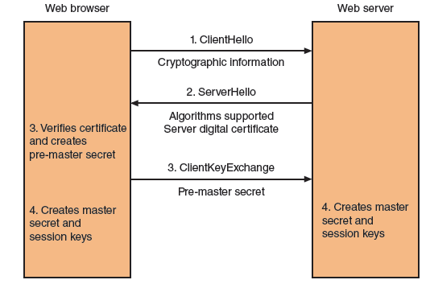
Digital Certificates - Types of Digital Certificates
- Domain Digital Certificates
Most digital certs are web server digital certs issued from a web server to a client
Web server digital certificates perform two primary functions
Ensure authenticity of the web server to the client
Ensure authenticity of the cryptographic connection to web server
To address the security of web server digital certificates, there are several types of domain digital certificates
Domain validation digital certificates
Extended validation (EV) digital certificates
Wildcard digital certificates
Subject alternative name (SAN) digital certificates
The handshake setup between web browser and web server, also called a key exchange.
Dr. M Malook Rind Information Security Lecture 7

Slide 16
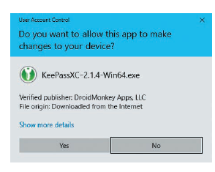
Digital Certificates - Types of Digital Certificates
- Hardware and Software Digital Certificates
More specific digital certs relate to hardware and software
Machine/computer digital certificate: is used to verify the identity of a device in a network transaction.
Code signing digital certificate: used by software developers to digitally sign a program to prove that the software comes from the entity that signed it and no unauthorized third party has altered or compromised it.
Email digital certificate: allows a user to digitally sign and encrypt mail messages.
Verified publisher message
Dr. M Malook Rind Information Security Lecture 7

Slide 17
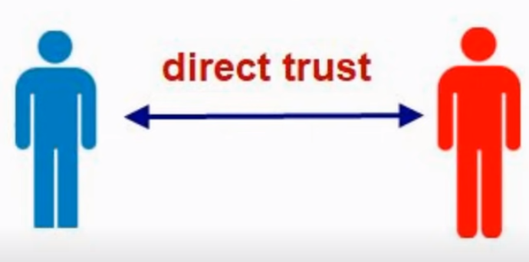
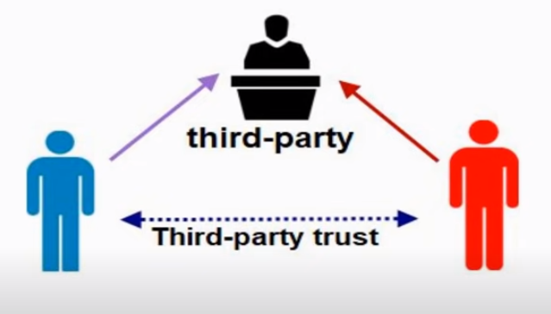
Public Key Infrastructure (PKI) - Trust Models
Trust is defined as confidence in or reliance on another person or entity.
One of the principal foundations of PKI is that of trust: Alice must trust that the public key in Bob’s digital certificate belongs to him
Trust model refers to type of trust relationship that can exist among individuals/entities
Direct trust is a type where one person knows the other person.
Third-party trust refers to a situation where two individuals trust each other because each trusts a third-party -Web of trust model is based on direct trust.
In PKI trust comes form third party
3 PKI trust models use a CA
The Hierarchical trust model,
The distributed trust model,
The bridge trust model
Dr. M Malook Rind Information Security Lecture 7

Slide 18
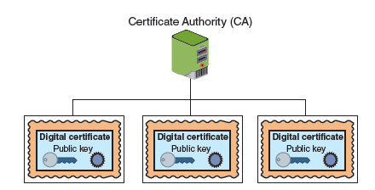
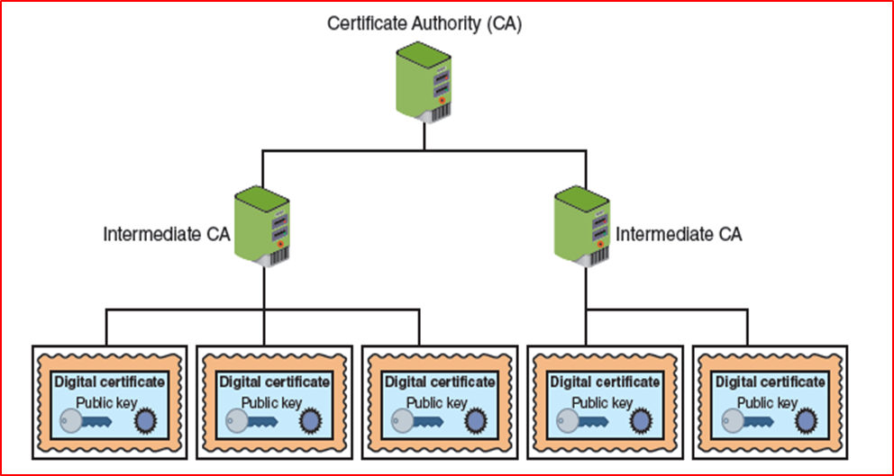
Public Key Infrastructure (PKI) - Trust Models
Hierarchical Trust Model
Assigns single hierarchy with one master CA called root
Root signs all digital cert authorities with a single key
can be used in an organization where one CA is responsible for only the digital
certificates for that organization
Limitations
Single CA private key may be compromised; render all certs worthless
Distributed Trust Model
The distributed trust model has multiple CAs that sign digital certificates
The loss of a CA’s private key would compromise only those digital
certificates it had signed
This trust model is the basis for most digital certificates used on the Internet
Hierarchical trust model
Distributed trust model
Dr. M Malook Rind Information Security Lecture 7

Slide 19
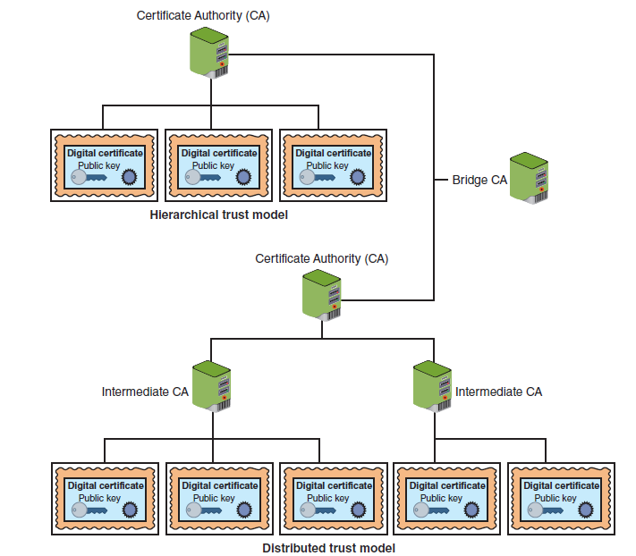
Public Key Infrastructure (PKI) - Trust Models
Bridge Trust Model
is similar to the distributed trust model in that no single CA signs digital certificates.
However, one CA acts as a facilitator to interconnect all other CAs.
The facilitator CA does not issue digital certificates; instead, it acts as the hub between hierarchical trust models and distributed trust models, linking the models together
Bridge trust model
Dr. M Malook Rind Information Security Lecture 7

Slide 20
Public Key Infrastructure (PKI) - Managing PKI
An organization that uses multiple digital certificates on a regular basis needs to properly manage those digital certificates.
Effective management includes establishing policies and practices and determining the life cycle of a digital certificate.
Certificate Policy (CP):
is a published set of rules that govern the operation of a PKI.
provides recommended baseline security requirements for the use and operation of CA, intermediate CA, and other PKI components.
should cover CA or intermediate CA obligations, user obligations, confidentiality, operational requirements, and training
Certificate Practice Statement (CPS):
a more technical document than a CP and describes in detail how the CA uses and manages certificates.
how users register for a digital certificate,
how to issue digital certificates,
when to revoke digital certificates,
procedural controls, key pair generation and installation,
and private key protection
Dr. M Malook Rind Information Security Lecture 7

Slide 21
Public Key Infrastructure (PKI) - Managing PKI
Certificate Life Cycle:
Digital certificates do not last forever: employees leave, new hardware is installed, applications are updated and cryptographic standards evolve.
Each change affects the usefulness of a digital certificate.
The life cycle of a certificate is typically divided into four parts:
Creation: At this stage, the certificate is created and issued to the user. Before the digital certificate is generated, the user must be positively identified.
Suspension: This stage could occur once or multiple times throughout the life of a digital certificate if the certificate’s validity must be temporarily suspended
Revocation: At this stage, the certificate is no longer valid. Under certain situations, a certificate may be revoked before its normal expiration date, such as when a user’s private key is lost or compromised.
Expiration: At the expiration stage, the certificate can no longer be used. Every certificate issued by a CA must have an expiration date. Once it has expired, the certificate may not be used for any type of authentication.
Dr. M Malook Rind Information Security Lecture 7

Slide 22
Public Key Infrastructure (PKI) - Key Management
One common vulnerability that allows threat actors to compromise a PKI is improper certificate and key management.
Because keys form the foundation of PKI systems, they must be carefully managed.
Proper key management includes key storage, key usage, and key handling procedures.
Key Storage
Public keys can be stored by embedding them within digital certificates, while private keys can be stored on the user’s local system.
storing public keys, special CA root and intermediate CA hardware devices can be used.
Key Usage
If more security is needed than a single set of public and private keys, multiple pairs of dual keys can be created.
One pair of keys may be used to encrypt information, and the public key can be backed up to another location.
The second pair would be used only for digital signatures, and the public key in that pair would never be backed up
Key Handling Procedures
At this stage, different mechanisms such as Key Escrow, Expiration, Revocation, Recovery, suspension, and destrution are implemented.
Dr. M Malook Rind Information Security Lecture 7

Slide 23
Cryptographic Protocols
In addition to protecting data in processing and at rest, cryptographic algorithms are most often used to protect data in transit or motion across a network.
When cryptographic algorithms are used in networks, they are sometimes called cryptographic protocols.
The most common cryptographic protocols include:
Secure Sockets Layer (SSL)
One of the early and most widespread cryptographic protocols developed by Netscape in 1994.
The design goal was to create an encrypted data path between a client and a server.
The current version of SSL is Version 3.0.
The way SSL functions has left it vulnerable to attack.
Transport Layer Security (TLS)
is a widespread cryptographic protocol and is the replacement for SSL.
subsequent versions of TLS are significantly more secure and address several vulnerabilities in SSL v3.0.
The current version of TLS is v1.3.
Dr. M Malook Rind Information Security Lecture 7

Slide 24


Cryptographic Protocols
Secure Shell (SSH)
is an encrypted alternative to the Telnet protocol used to access remote computers.
SSH is actually a suite of the three utilities
slogin (secure login to a remote computer),
ssh (execute commands on a remote host without logging in),
scp (copy files between remote computers) that are secure versions of the unsecure UNIX counterpart utilities.
Both the client and server ends of the connection are authenticated using a digital certificate, and passwords are protected by being encrypted.
SSH can even be used as a tool for secure network backups.
Hypertext Transport Protocol Secure (HTTPS)
One common use of TLS and the older SSL is to secure Hypertext Transport Protocol (HTTP) communications between a browser and a web server.
The secure version is “plain” HTTP sent over TLS or SSL and is called Hypertext Transport Protocol Secure (HTTPS)
web browsers prominently displayed a visual indicator
Dr. M Malook Rind Information Security Lecture 7

Slide 25
Cryptographic Protocols
Secure/Multipurpose Internet Mail Extensions (S/MIME)
a protocol for securing email messages.
MIME is a standard for how an electronic message will be organized, so S/MIME describes how encryption information and a digital certificate can be included as part of the message body.
It allows users to send encrypted messages that are also digitally signed.
Secure Real-time Transport Protocol (SRTP)
has several similarities to S/MIME.
is a secure extension protecting transmissions using the Real-time Transport Protocol (RTP).
provides protection for Voice over IP (VoIP) communications.
adds security features, such as message authentication and confidentiality, for VoIP communications.
IP Security (IPsec)
is a protocol suite for securing Internet Protocol (IP) communications.
encrypts and authenticates each IP packet of a session between hosts or networks.
can provide protection to a much wider range of applications than TLS or the older SSL
IPsec supports two encryption modes:
Transport mode: encrypts only the data portion (payload) of each packet yet leaves the header unencrypted
Tunnel mode: encrypts both the header and the data portion
Dr. M Malook Rind Information Security Lecture 7

Slide 26
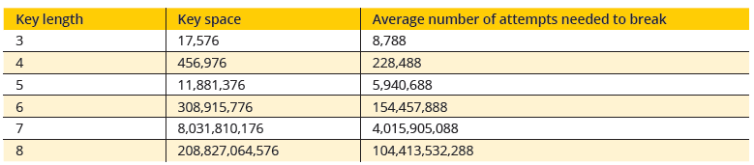
Implementing Cryptography
Cryptography that is improperly applied can lead to vulnerabilities that threat actors will exploit.
In order to properly and correctly implement cryptography it is important to consider:
Key Strength
A key (a random string of bits), serves as an input parameter for hash, symmetric encryption, and asymmetric cryptographic algorithms to transform plaintext into ciphertext.
Three primary characteristics determine the resiliency of the key to attacks
Randomness: A key is considered strong when it is random with no predictable pattern. A random key thwarts an attacker from attempting to uncover the key.
Cryptoperiod: or the length of time for which a key is authorized for use. Having a limited cryptoperiod helps protect the ciphertext from extended cryptanalysis and limits the exposure time if a key is compromised
Length of the key: Shorter keys can be more easily broken than longer keys. All the possible values for a specific key make up its key space. The formula for determining a given key space is character-set^{key-length}
the key space, and average attempts necessary to break the key for a 26-character alphabet
Dr. M Malook Rind Information Security Lecture 7

Slide 27
Implementing Cryptography
Secret Algorithms
Keys must be kept secret (except for public keys). the same apply to algorithms?
an enterprise may invest in hiring a cryptographer to create a new cryptographic algorithm and then hide the existence of that algorithm from everyone?
But this can not be considered same as equivalent to secret keys.
Block Cipher Modes of Operation
a block cipher manipulates an entire block of plaintext at one time.
A block cipher mode of operation specifies how block ciphers should handle separate blocks of plaintext.
some of the most common modes include Cipher Block Chaining (CBC), Electronic Code Book (ECB), Counter (CTR)
Crypto Service Providers
allows an application to implement an encryption algorithm for execution.
implement cryptographic algorithms, generate keys, provide key storage, and authenticate.
Crypto service providers can be implemented in software, hardware, or both and are often part of the operating system.
Dr. M Malook Rind Information Security Lecture 7

Slide 28
Thanks
Dr. M Malook Rind Information Security Lecture 7

